Slide 1



CAT M use case- Transport trailer asset management
REAL TIME COLLECTION AND DELIVERY OF ASSET DATA
UTILIZES CAT-M WITH PARTNER SENSORS & SECURITY FOR MASSIVE IOT
IMPROVES EFFICIENCY AND SECURITY, LOWERS COST AND INCREASES GROWTH OPPORTUNITIES
Notes:
Most solutions in the market today track the truck/cab/tractor, rather than the trailer. There are on average 10X more trailers than trucks.
Largely this is because of Cost and Battery Life.
The solutions which do exist are built on legacy wireless technologies, so a re-fresh will be required.
Hence the time is right to introduce a low cost, long battery life, tracking solution for Trailers.
The trucking industry isn’t yet digitized – there is a big opportunity to carry them forward with a simplified plug and play solution.

Slide 2
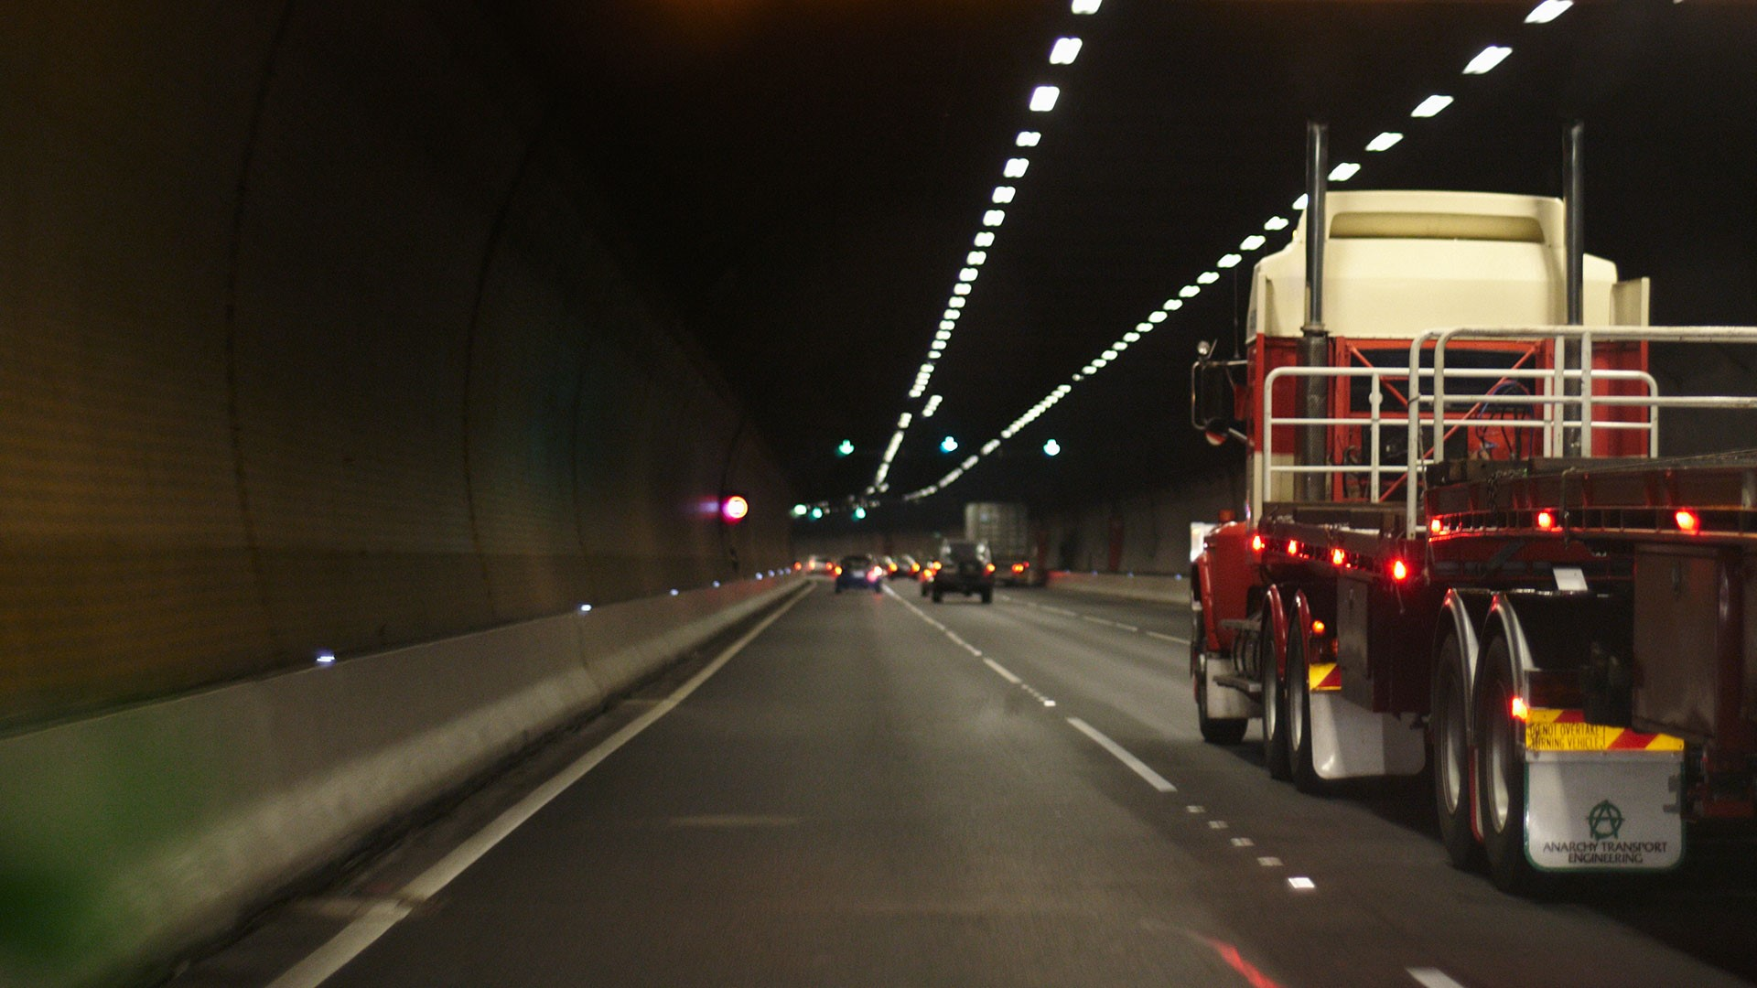
Customer value
EFFICIENCY
COST
SECURITY
REVENUE GROWTH
Notes:
Transport trucking companies always need to know:
Where are my trailers, and is my fleet being used efficiently? If I had the data about the location of my trailers, I could easily plan new routes and pickups, and less trailers would be left idle.
How can I track my trailers for maintenance? If I knew how much mileage was on each trailer, and could track the wear and tear, I could prevent unnecessary delays caused by breakdowns and emergency maintenance.
How will I know if the trailers are involved in an accident or compromised? If I knew immediately, I could make sure my drivers are safe, emergency response is dispatched, and the contents of the shipment are secure and dealt with in a timely manner.
How can I increase revenue? I need new ways to use the technology in which I have invested to make more money. Reduce the amount of time trailers are idle – make more money. If I could measure and control the temperature, air pressure, or even the oxygen and carbon dioxide levels of the contents of my trailers, I might be able to offer new services to new customers and increase my revenue.

Slide 3

Differentiator using cat-m or nB iot
60%
10+
7x
DEVICE COST REDUCTION
YEARS BATTERY LIFE
BETTER COVERAGE
OPTIMIZED FOR IOT DIVERSITY
Enables extensive reuse of site assets
Lower module and chipset cost
Chip-level power profiles adapt according to traffic patterns and use cases
Extended Narrowband Coverage using CAT-M
Addresses massive IoT requirements for flexibility and scalability
Notes:
Why would I choose this solution over the others currently available on the marketing using GSM and LTE?
Existing solutions on the market are not fully meeting customer needs. A refresh is required due to shutdown of GSM and limited investment in WCDMA
The Ericsson CAT-M offering enables extensive reuse of site assets such as radio and modern baseband units, as well as pooling of computational resources, saving network resources and cost.
The Monarch chip is designed and optimized to support low data use, ultra low-power, cost-sensitive, narrowband IoT applications
The Sequans Monarch chip supports Dynamic Power Management (DPM), that dynamically adapts chip-level power profiles in real time based on traffic patterns and use cases, making possible 10-15 years of battery life in real-world IoT applications. Existing solutions were cost prohibitive.
CAT-M supports the first wave of IoT use cases requiring 15-20 dB extended coverage as compared to today’s baselines GSM and LTE.
The solution enables separation of resources for mobile broadband and IoT as well as the flexibility and scalability needed for the predicted growth of IoT.

Slide 4
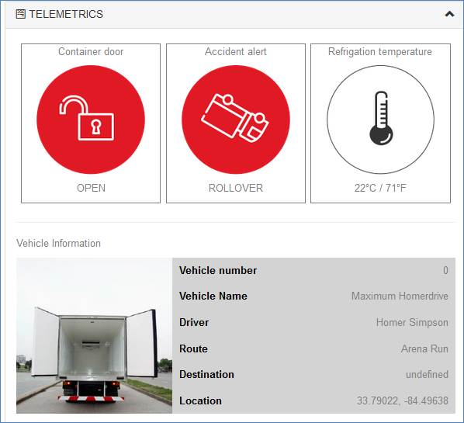
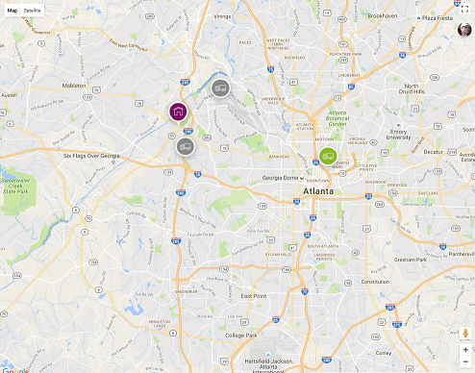
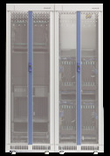
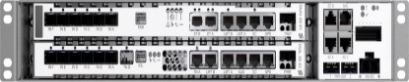
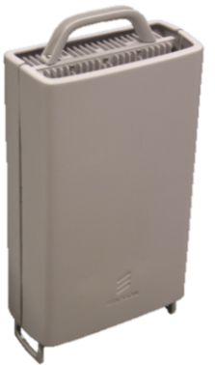
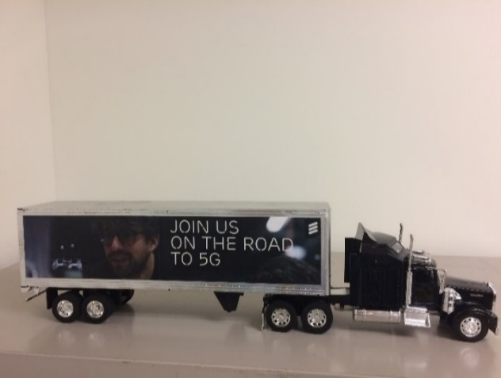
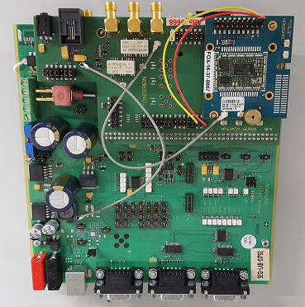
Ericsson building blocks
Web GUI
Ericsson AppIoT
Ericsson Core Network
Ericsson MI 17A RAN SW
RBS6601
CPRI
RF Cable
RPi
mRRU
Sequans/Gemalto
CAT-M

Slide 5
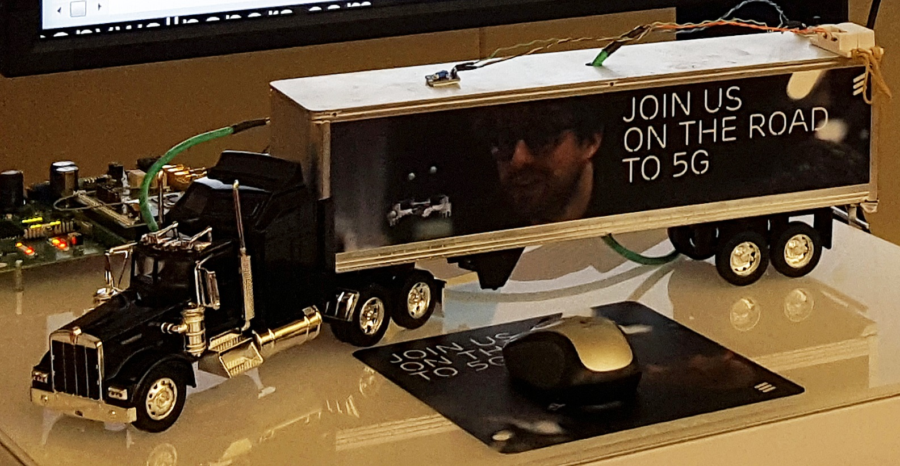
demo

Slide 6
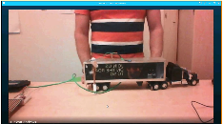
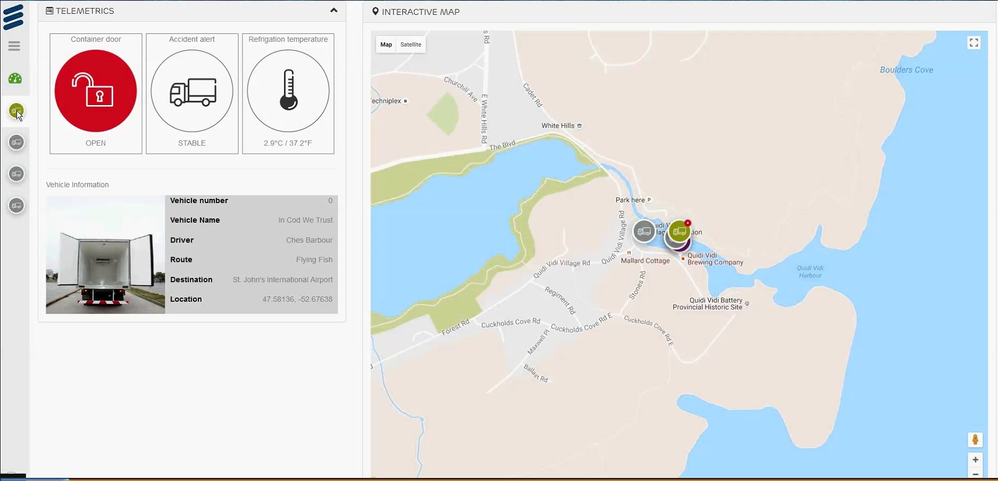
Loading: Door Open
Notes:
Fresh fish has to be delivered from the fish processing plant to the St. John's airport, 9 km away, in a timely manner, so that the fish can arrive in Toronto in plenty of time to be cooked for supper.
At the fish plant, the truck's doors are opened so that the fresh fish can be loaded into the trailer. The trailer must be kept between 0ºC and 5ºC. If the fish is kept at temperatures outside of this range for too long, it may spoil.
In the picture, you can see that the door sensor is open (one part of the door sensor is hanging over the side of the trailer).

Slide 7
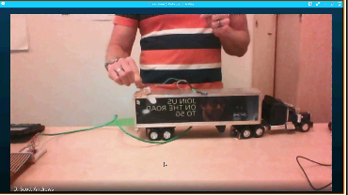
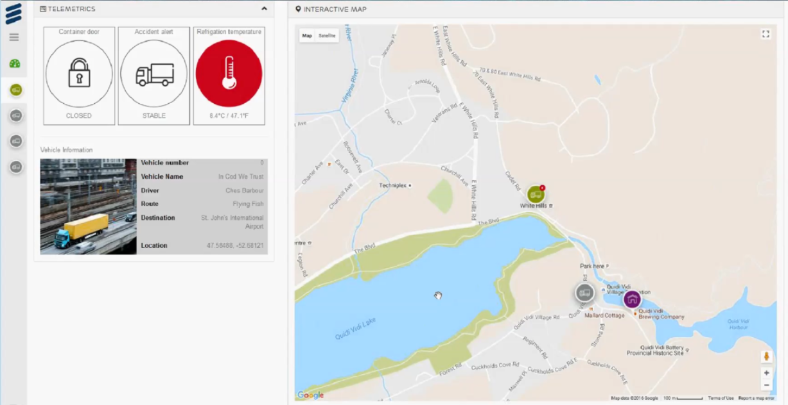
In Transit: High Temperature
Notes:
While in transit to the airport, the temperature in the trailer rises above 5ºC, threatening the freshness of the fish.
Scott is holding the temperature sensor between his thumb and forefinger in order to heat it up to trigger the alarm.

Slide 8
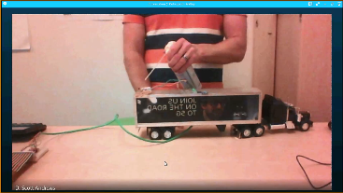
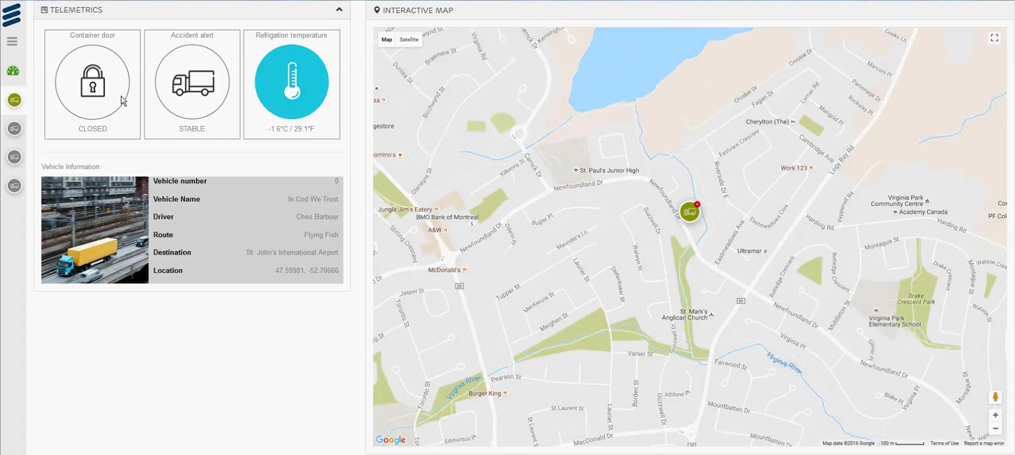
In Transit: Low Temperature
Notes:
Oh no! Now the trailer has been cooled too much! The fish might freeze.
The temperature sensor was cooled by blowing on it with a can of compressed air.

Slide 9
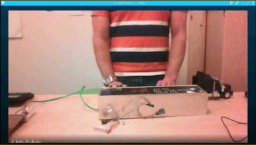
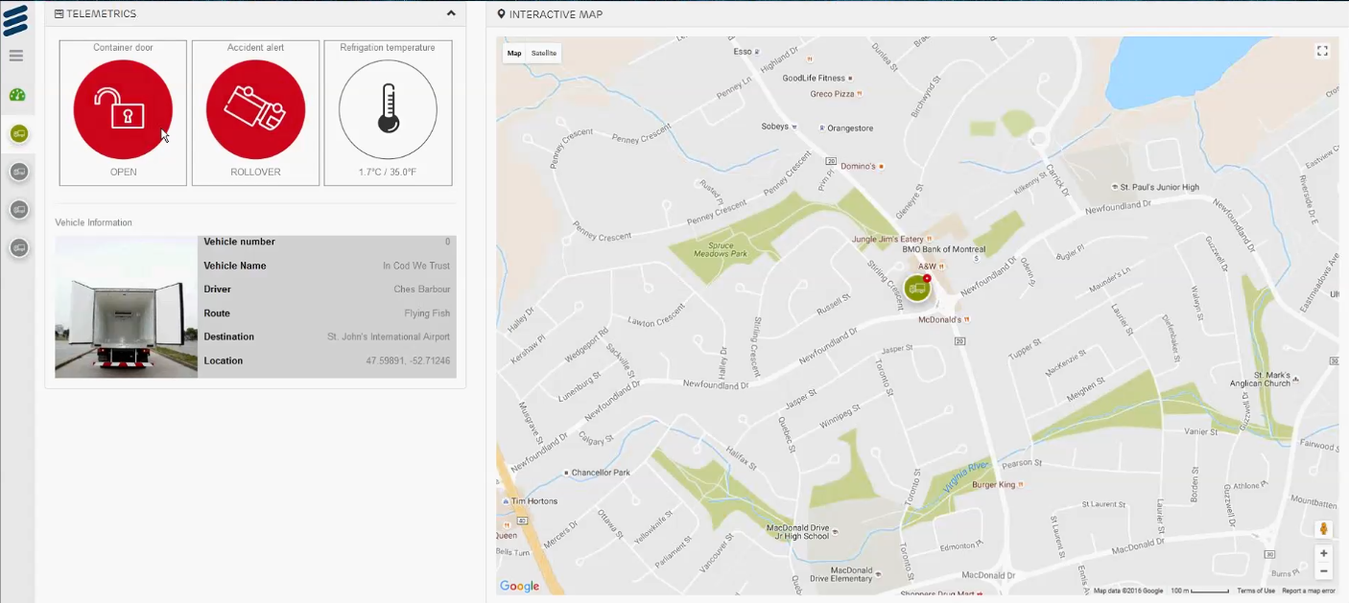
In Transit: Accident
Notes:
Oops! The truck has rolled-over and the doors have broken open.
Our model trailer was turned on its side, triggering both the tilt sensor and the door sensor.

Slide 10
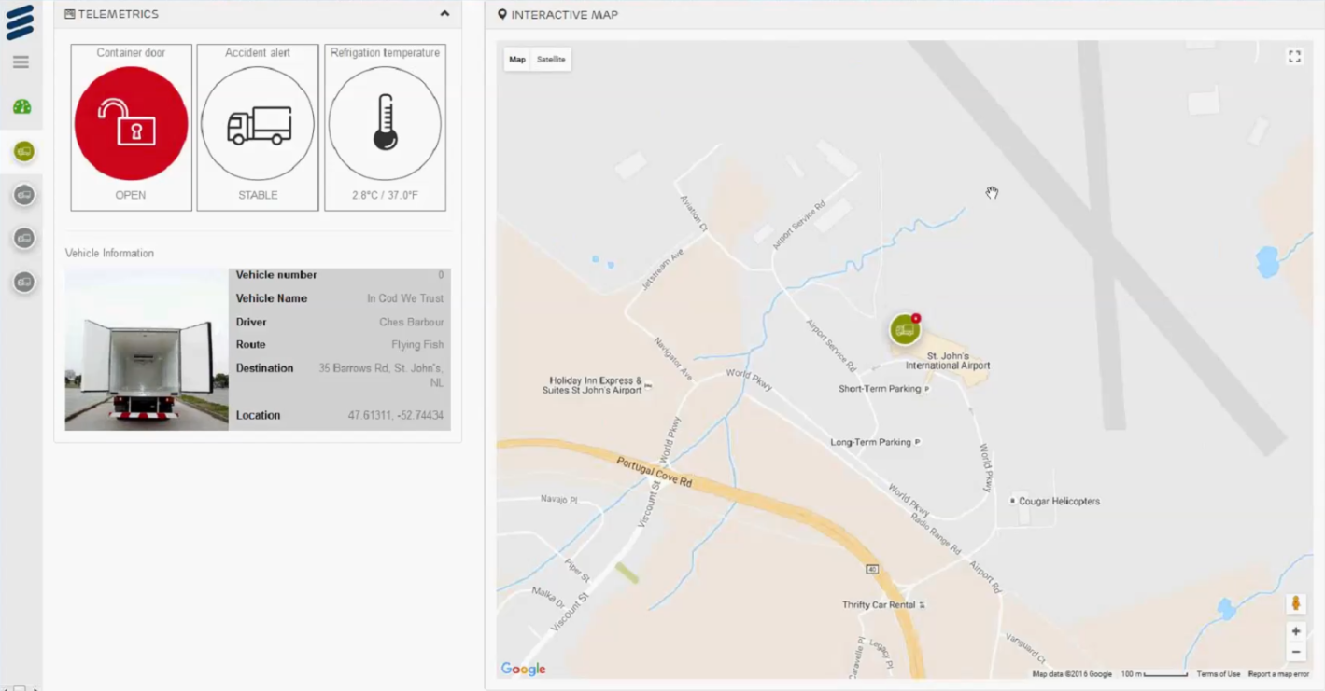
UNLOADING: Door open
Notes:
Finally, after everything that has happened, the truck arrives at the St. John's airport just in time and begins unloading the fresh fish.
In the picture, you can see that the door sensor is open (one part of the door sensor is hanging over the side of the trailer).

